Slide 1
Data-Driven Retail: Business Intelligence and AI-based predictive Sales Forecasting by Christian und Mario
Notes:
Christian:
„Wie Albert Einstein einmal sagte: Inmitten von Schwierigkeiten liegen die Möglichkeiten. Heute möchten wir euch die Geschichte von Marc erzählen, der genau das erlebt hat.“

Slide 2

Our story…
Notes:
Christian:
“Marc is a very conscientious and meticulous owner of a large, well-known retail business. Marc is a true hero in his industry; he is seasoned and has experienced a lot. But like every hero, he faces significant challenges, especially during the Christmas season.”

Slide 3
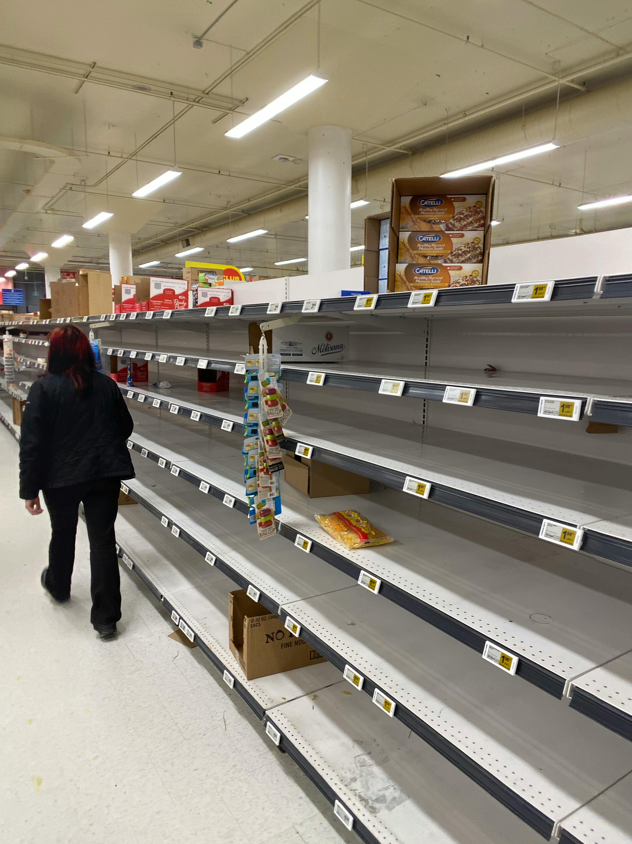
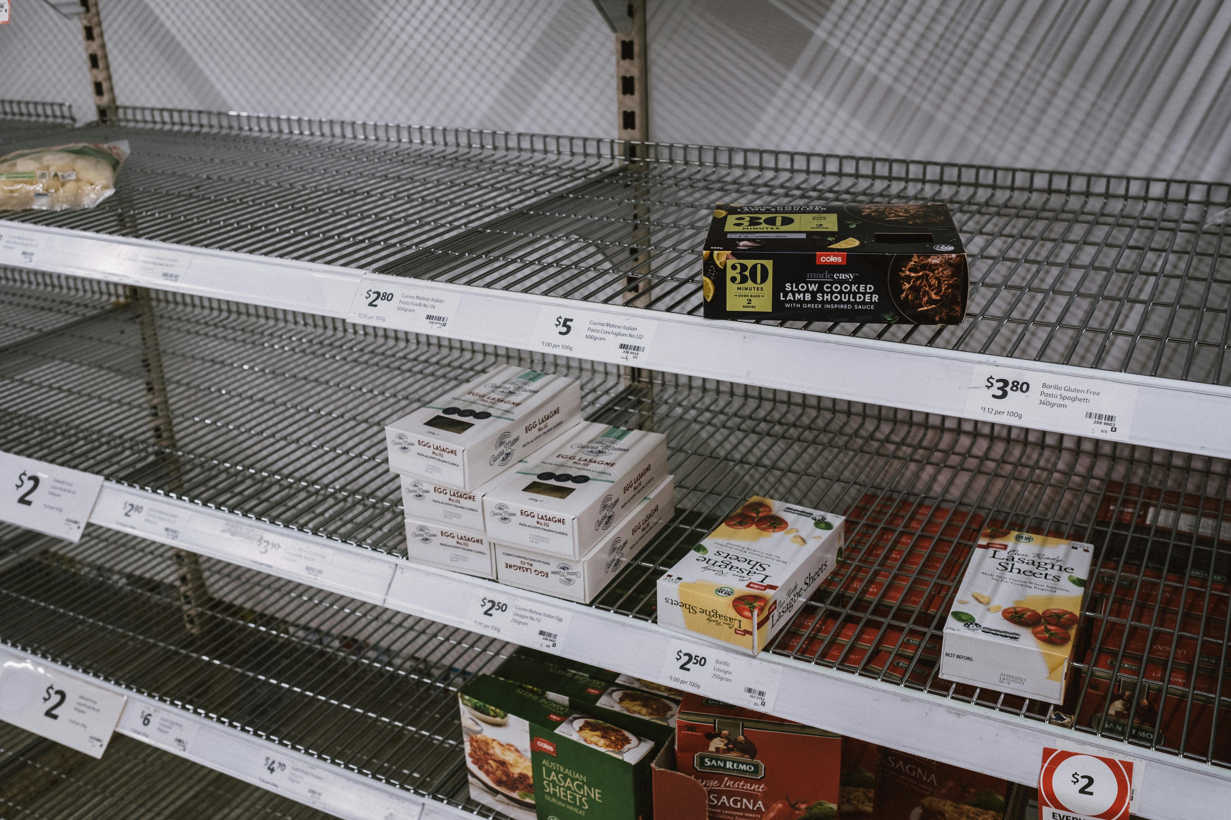


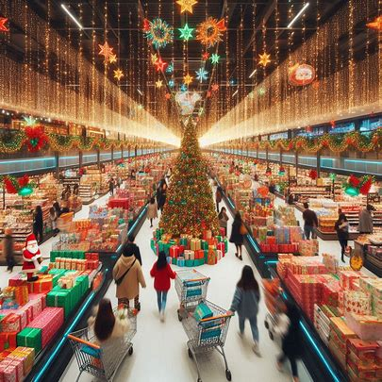
A balancing act…
Notes:
Christian:
“He himself bears the responsibility. He is in charge of ensuring that the shelves are always well-stocked, but also that there isn’t too much inventory, especially with perishable products. Inventory management is a constant, challenging balancing act between supply and demand, practically unpredictable. Ultimately, success determines the profit or loss of a business.”

Slide 4
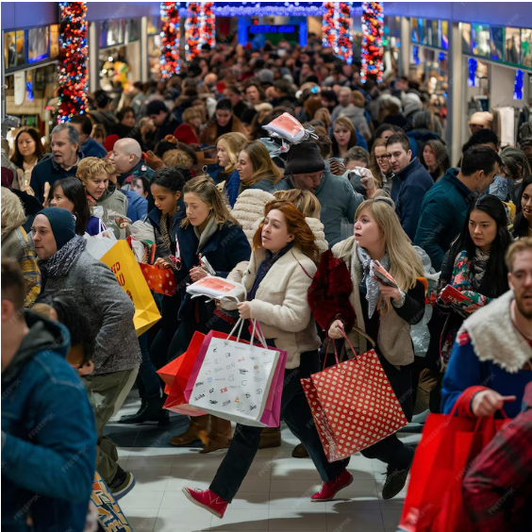
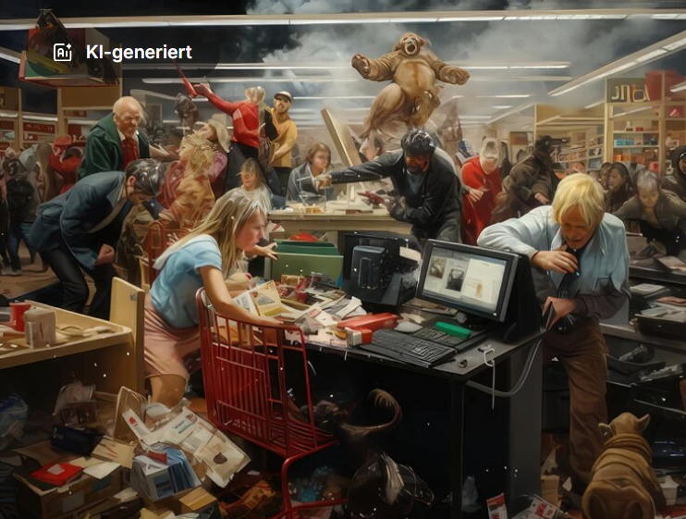
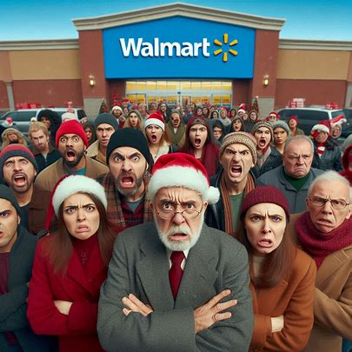

The collapse…
Notes:
Christian:
“Just before Christmas 2012, Marc lost control of the situation for the first time in 40 years. Important Christmas items were sold out, and disappointed customers left his store without making any holiday purchases! — Marc had miscalculated!”

Slide 5




The turning point…
Notes:
Christian:
“The setback was a turning point for Marc. He realized that he could no longer keep up with the changing consumption habits of young people and the dynamic market. As early as January 2012, he asked us for help to develop an app that would support him in his business year-round. To this end, Marc provided us with an initial dataset for testing.”

Slide 6
Conclusion
Departments & marketing measures are the biggest influences
Sales peaks at the end of the year
9 strong-selling departments
Fuel prices and CPI show an upward trend
Christmas sales are expected to rise again in the following year
Notes:
“We tested the app with Marc’s sample dataset and found that Marc no longer has to worry about the Christmas season or other sales days. The app provides him with an overview of his sales at any time and enables precise forecasts with an accuracy rate of 95–96%. It also helps him incorporate the changing buying behavior into his inventory planning. From the trial run, we gained the following valuable insights:
Departments and marketing measures have the strongest influence on sales.
There is a significant sales increase at the end of the year (Thanksgiving, Christmas, MD3, MD5).
Nine main departments drive revenue, with larger stores benefiting particularly.
CPI and rising fuel prices weaken purchasing power, explaining the poor Christmas sales in 2011.
For 2013, Marc can expect rising Christmas sales again with high probability (95%) and should prepare accordingly.”

Slide 7
Recommendations
Conduct benchmarking between stores
Server connection for the app
Integration of additional modules into the app
Notes:
Mario: “With our findings, we want to provide Marc with a few recommendations.” “Marc should conduct a benchmark analysis between his stores to understand why certain departments are only successful in larger stores and how he can strengthen weaker branches regionally. Unfortunately, the test dataset was not sufficiently equipped for such an analysis. We recommend connecting the app to Marc’s server to utilize real-time data and ensure continuous monitoring of his sales. Additionally, we suggest integrating a real-time inventory management system that is linked to the cash register system. This way, stock levels could be monitored, optimal order quantities and times calculated, and even automated ordering implemented.”

Slide 8
Thank you very much!
Notes:
Mario: “Yes, that was our story! The story began with a quote from Albert Einstein, and it should end the same way. ‘As Albert Einstein said, “Creativity is intelligence having fun.” So let’s approach the challenges creatively and joyfully seize the opportunities that come our way. In that spirit... Happy Forecasting!” =)

